Slide 1
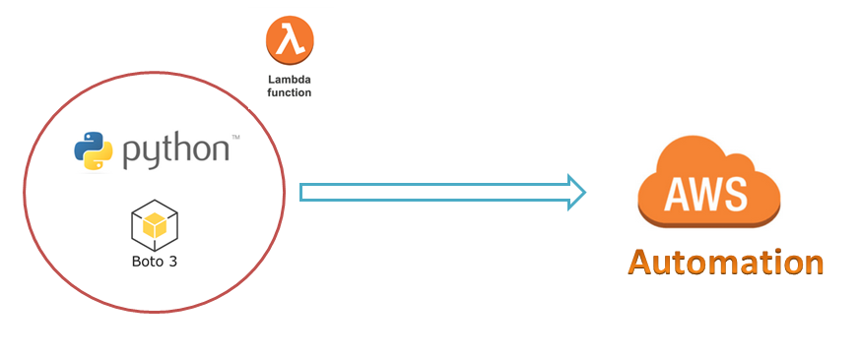
AWS Automation
with
boto3 of Python and Lambda Functions
Executing Python boto3 Scripts using IAM roles
(Use default session while working with IAM Roles)
Loop control statements or commands
(break and continue)
Learn how to automate AWS common tasks using boto3 and Lambda

Slide 2
Thank you

